Slide 1




“From Disparity To Progress”:
Mapping Gender Inequality Across the World
DS612 Interactive Data Visualization
Prof. Bhaskar Chaudhury
Team Members:
Naman Gandhi- 202418038
Anujit Nair- 202418036
Dhruv Jain - 202418020
Meet Panchal - 202418042

Slide 2

Table of Contents
Introduction
Our Aim
Problem Statement
Hypotheses & Key Questions
Actionable Insights
Conclusion

Slide 3
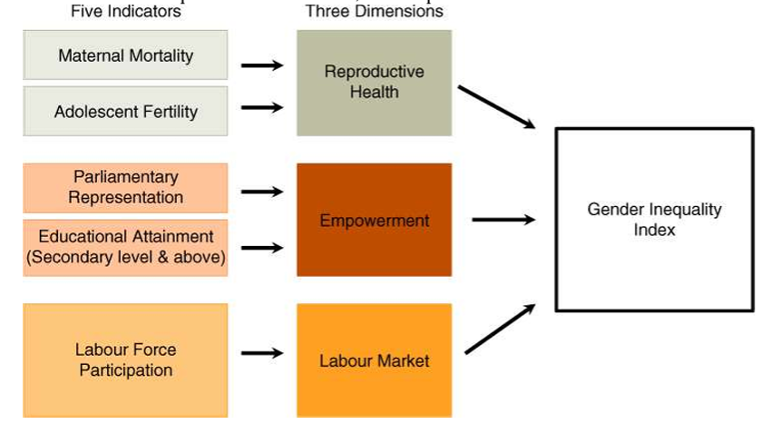
Introduction
In a world striving for equality and progress, the lived experiences of women and men still differ drastically across regions and countries. These differences are not just anecdotal—they are measurable.
What is GII?
The Gender Inequality Index (GII) is a composite measure introduced to reflect gender-based disadvantage in three key dimensions:
Reproductive Health:
Empowerment
Labor Market Participation

Slide 4
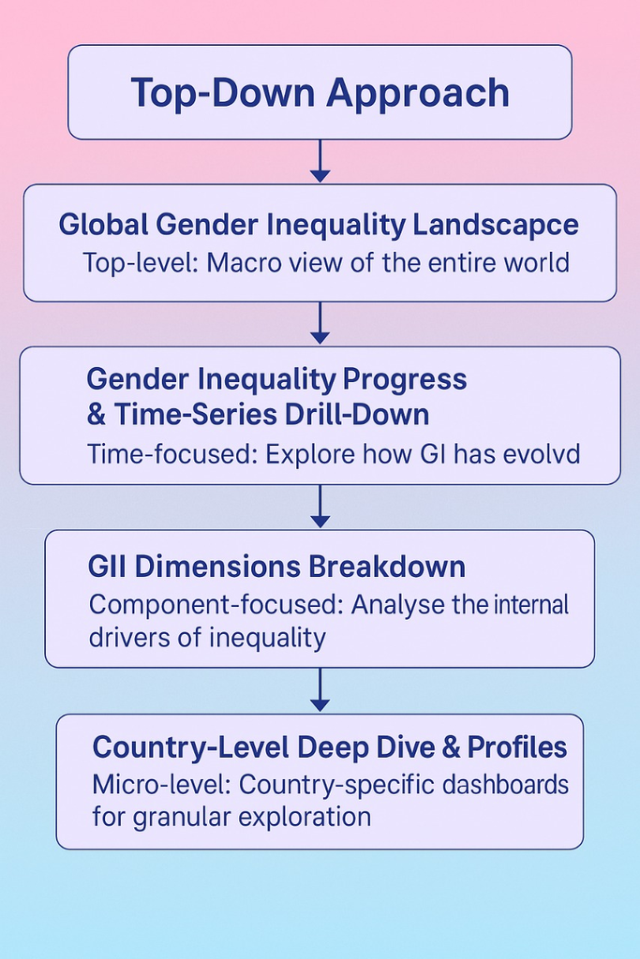
Our Aim: Turning Data into Direction
Gender inequality is not just a social issue—it's a developmental challenge that affects health, education, economics, and governance.
While the GII provides a quantitative lens, our mission is to transform this data into a visual, interactive, and comprehensible story that highlights both progress and persisting disparities.

Slide 5
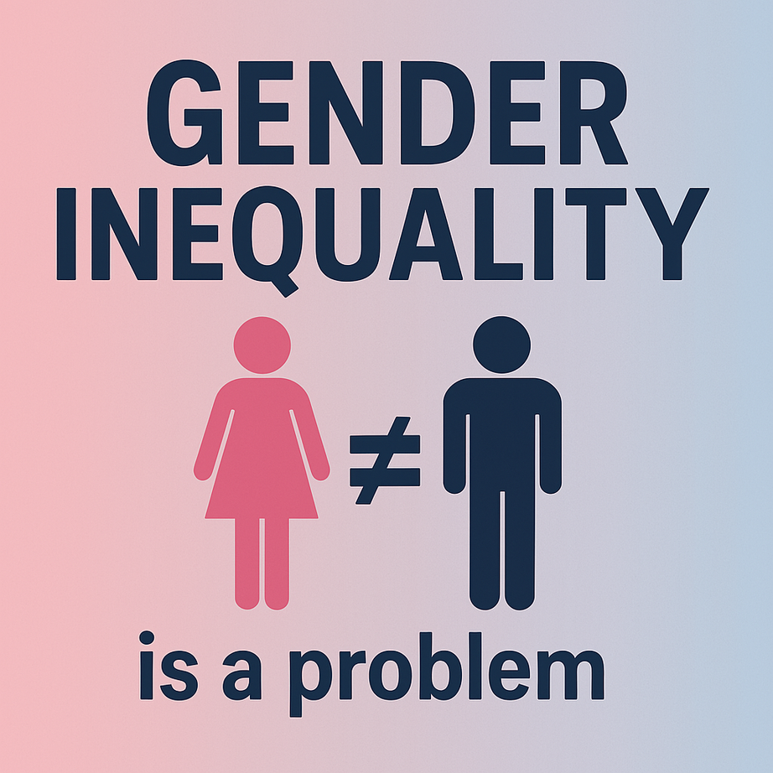
Problem Statement
This project seeks to analyse gender inequality through a multi-level lens—from global and regional trends to individual country profiles—using data from 1990 to 2021. Specifically, we aim to:
Understand how gender inequality has evolved over time, and whether countries in different continents, hemispheres, or developmental groups have experienced faster or slower progress;
Identify which dimensions of inequality (e.g., maternal mortality, education gaps, labour force participation) are most impactful in driving GII scores;
Detect outlier countries that have defied regional trends—either by rapidly improving or stagnating;
Assess whether countries are converging toward equality, or if global progress hides widening gaps in certain regions or indicators.

Slide 6
Chapter I:
Global Gender
Inequality Landscape

Slide 7
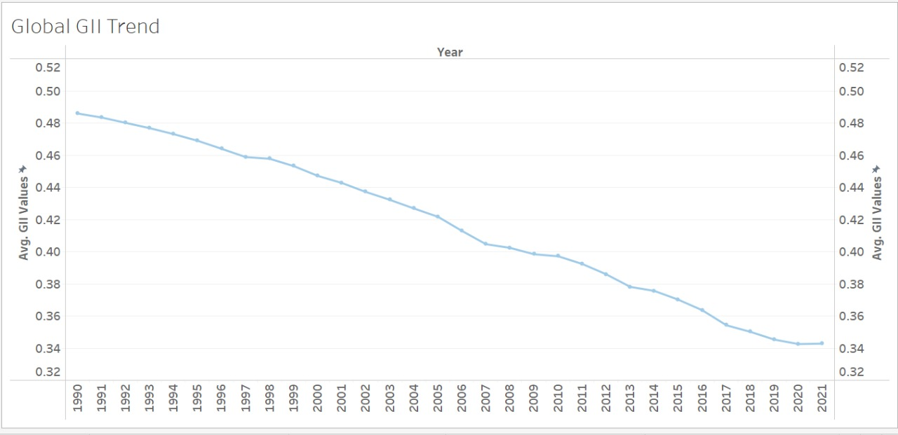
Hypothesis 1: There has been a significant reduction in the Average Global GII values from 1990 to 2021

Slide 8
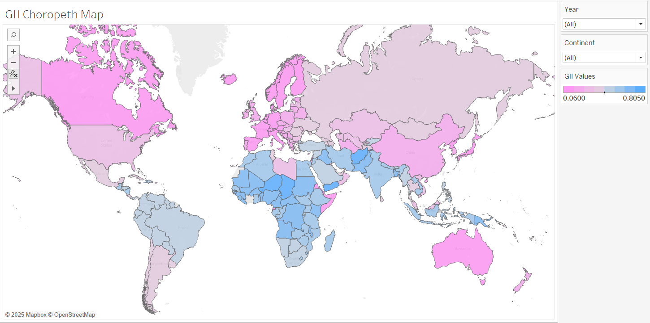
Hypothesis 2: Is there a geographic pattern in gender inequality based on hemisphere and continents.
Chapter 1: Global Gender
Inequality Landscape

Slide 9
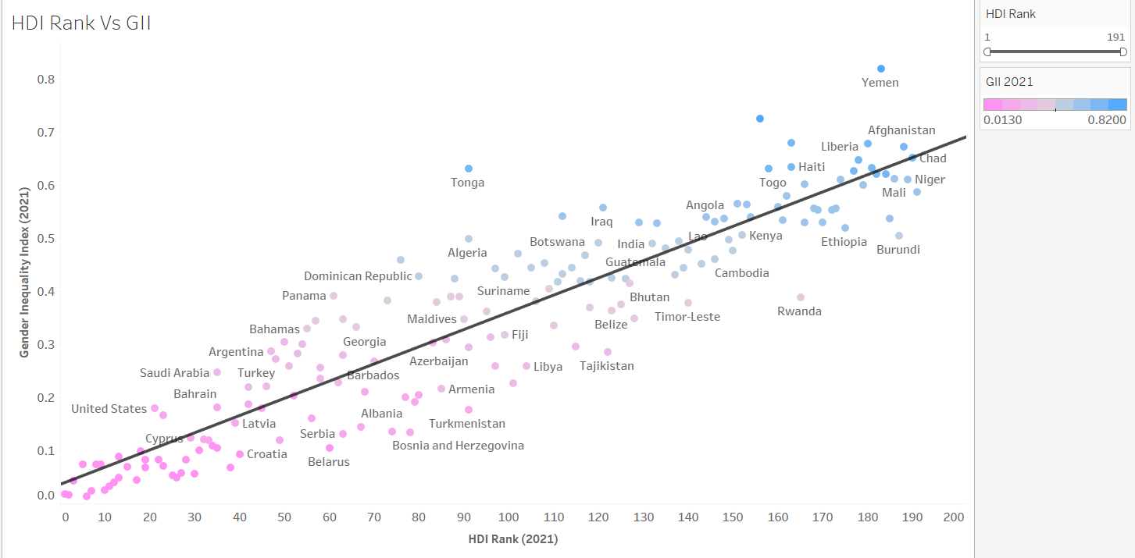
Hypothesis 3: Is there a relation between GII Value and HDI Rank?

Slide 10

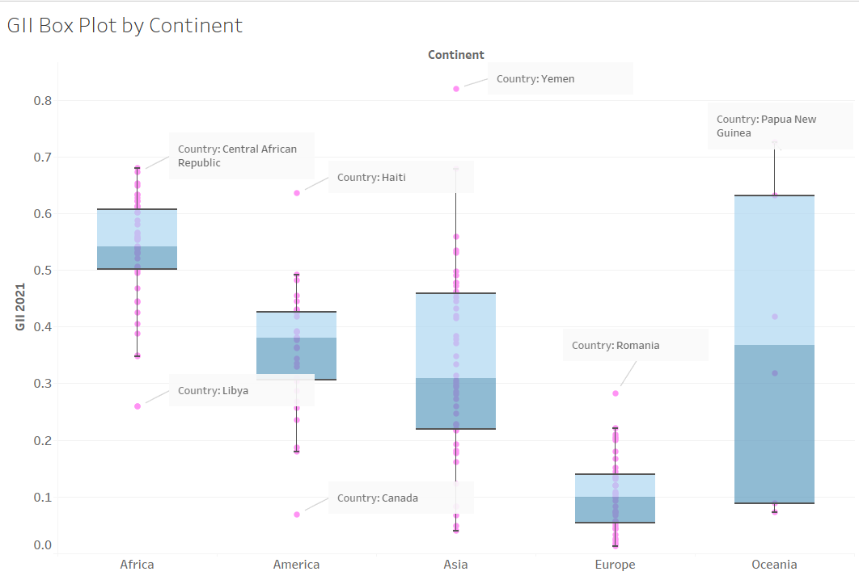
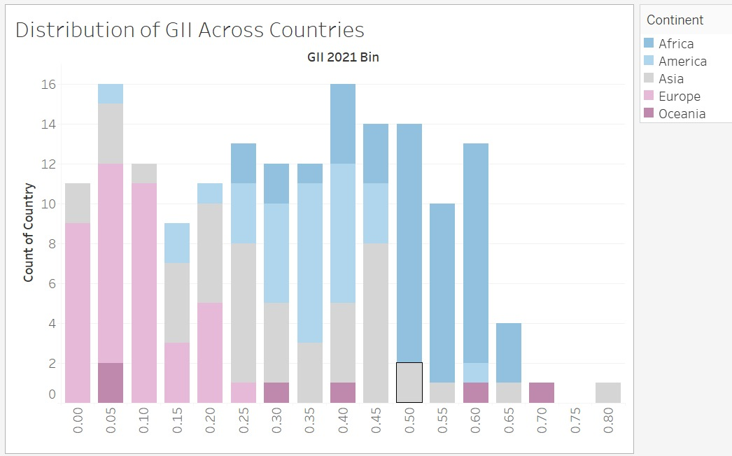
Question 1: What is the Global Distribution of Gender Inequality?
Question 2: Which countries are outliers in each of the continents?

Slide 11
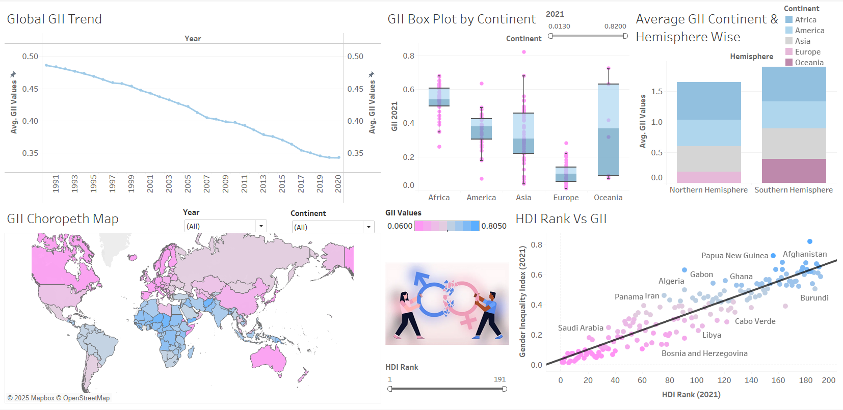
Global GII Analysis

Slide 12
Chapter II:
Gender Inequality Progress & Time Series Drill-Down

Slide 13
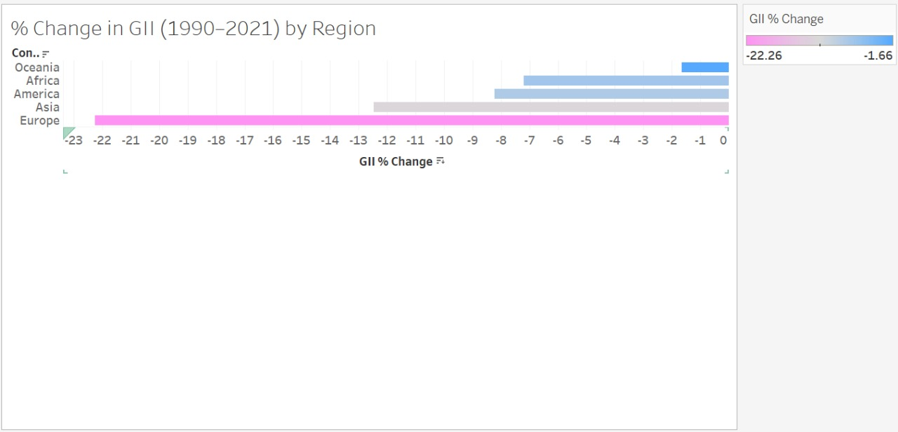
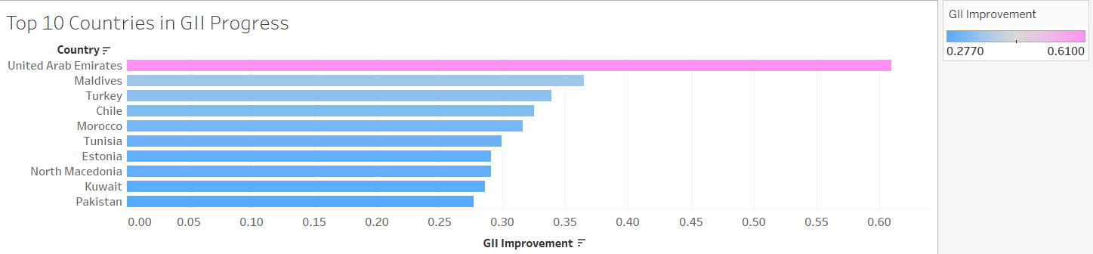
Hypothesis 4: Most regions have shown improvement over time, but at uneven rates.
Question 3: Which Countries have shown the Highest progress over the period?

Slide 14
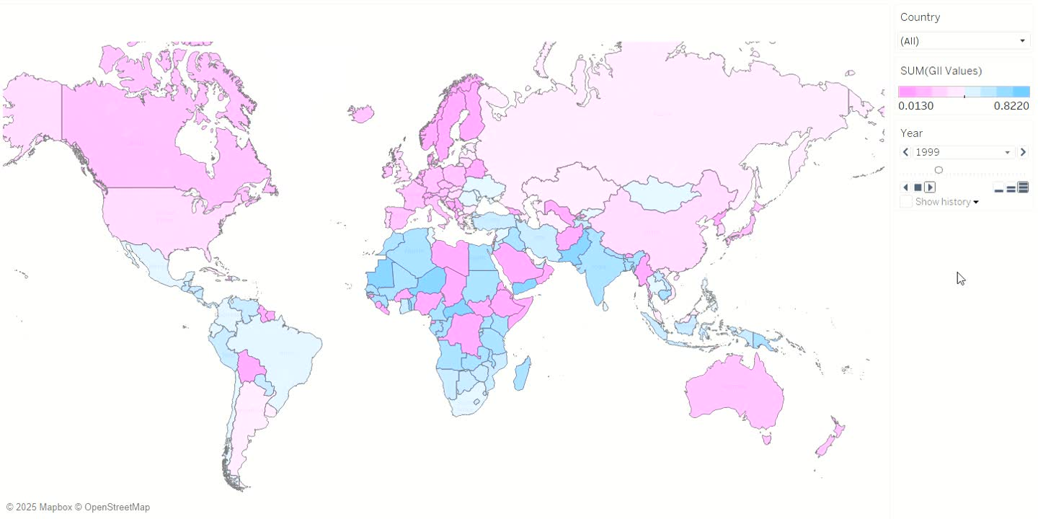
Question 4: How has GII changed for different countries over the span of 30 years?

Slide 15

Chapter III:
GII Dimensions Breakdown

Slide 16
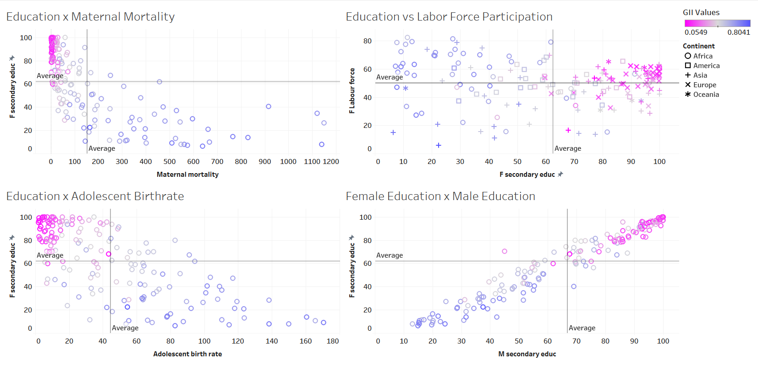
Hypothesis 5: Female Education have a significant impact on Components of GII

Slide 17
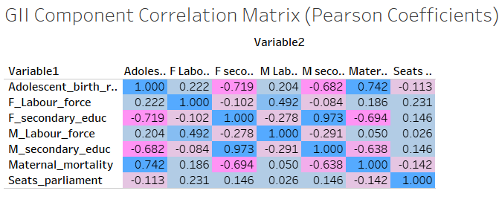
Hypothesis 6: Do the Components of GII show Correlation with each other?

Slide 18
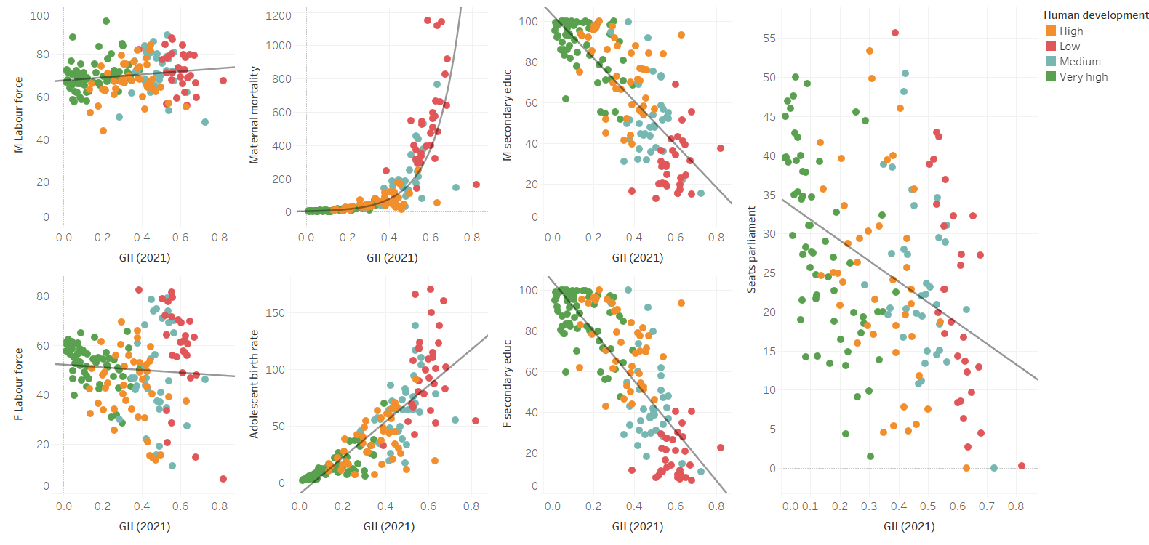
Question 5: Which individual indicators are most strongly correlated with overall GII?

Slide 19
Chapter IV:
Country-Level Deep Dive & Profiles

Slide 20
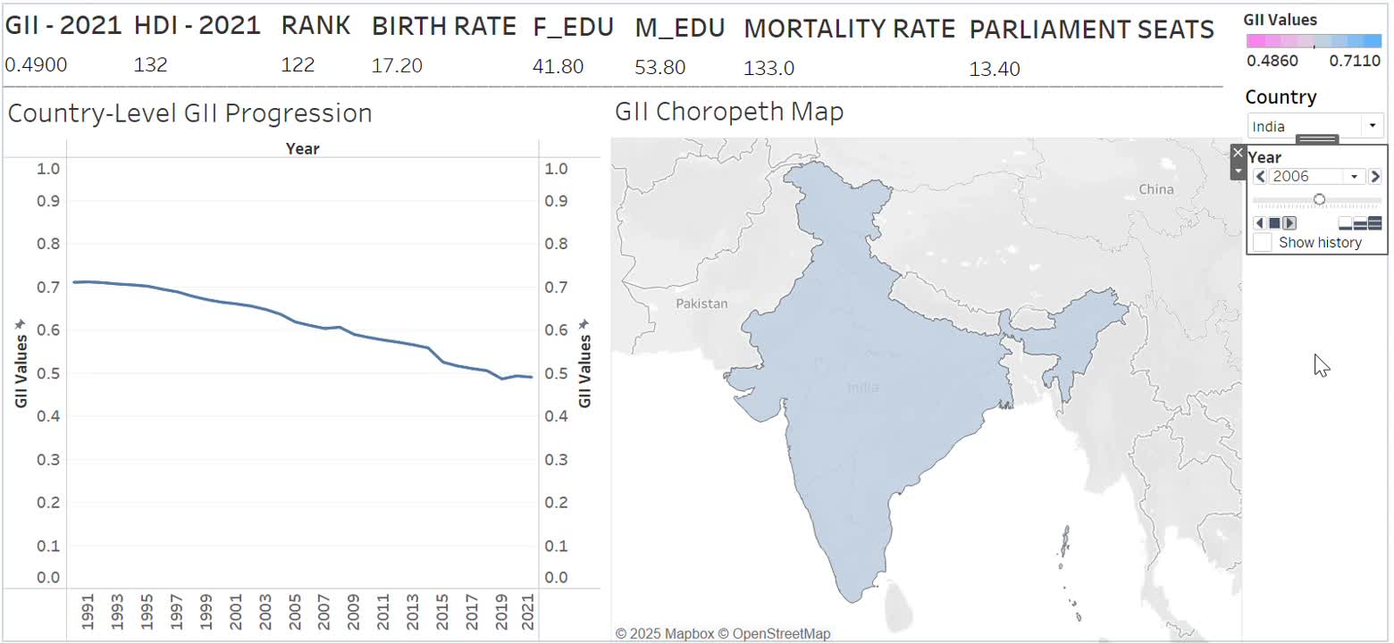
Question 6: How has the trend and the KPI of Each country changed over the time? (For India)
-

Slide 21
Actionable Insights
Invest in Female Secondary Education
Improve Maternal Health Infrastructure
Reduce Adolescent Birth Rates Through Awareness
Promote Women’s Economic Participation
Increase Female Political Representation
Target Regions with Persistently High GII
Leverage Success Stories

Slide 22
Conclusion
Over the past three decades, the world has made commendable strides in reducing gender inequality, as evidenced by the declining Global GII trend. However, progress is uneven across regions and development levels. Our multi-dimensional analysis shows that education, health, economic participation, and political inclusion remain crucial levers for gender parity. To accelerate this progress, countries must adopt evidence-based, intersectional, and inclusive policies, particularly in underperforming regions. This project not only maps where inequality persists but also lights the path toward equity, empowerment, and sustainable human development.

Slide 23
